Slide 1

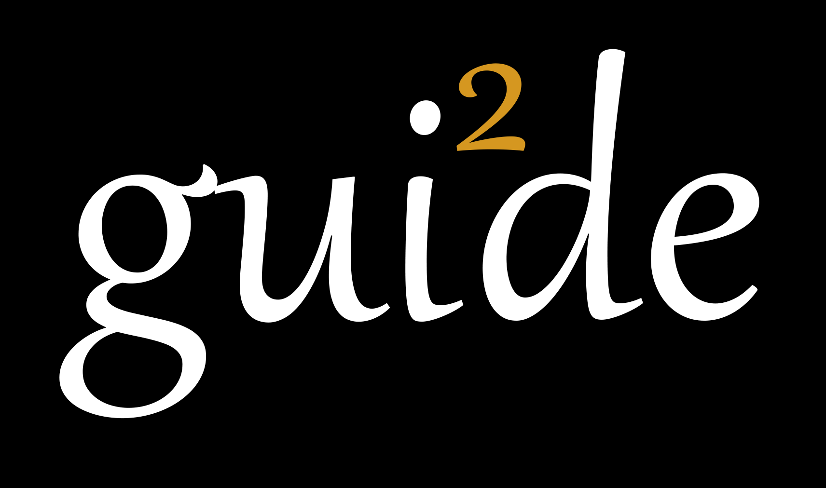
IRC BILLY PROJECT
Covid 19 Phone Survey
13th May 2020

Slide 2
Training Agenda
Covid 19 Phone Survey Background
Covid 19 Questionnaire – Paper version
Covid 19 Questionnaire– Tablet Version/ Case Management
Phone Survey Protocol & Quality Controls
Project Timeline

Slide 3
Covid 19 Phone Survey Background
Why covid 19 phone survey?
Just like the rest of the world, Kenya has also been affected by covid 19
The survey objective is to provide health and economic surveillance in the face of the crisis. That is;
Has their work status changed?
Has their consumption changed?
Have the prices of consumptions changed?
What coping mechanisms are they employing?
These answers will help our program partner & general public/ policy makers better understand the economic, health and social consequences faced by the population how best to respond
* All phase 1 clients (Recruited last year) to be reached for feedback periodically

Slide 4
Questionnaire Discussion
During this session, the group will go through the questionnaire question by question
Each FO will guide us through a module
Read each one out plus options loud and we discuss as a group:
How could the question be confusing?
How would you probe or explain further?

Slide 5
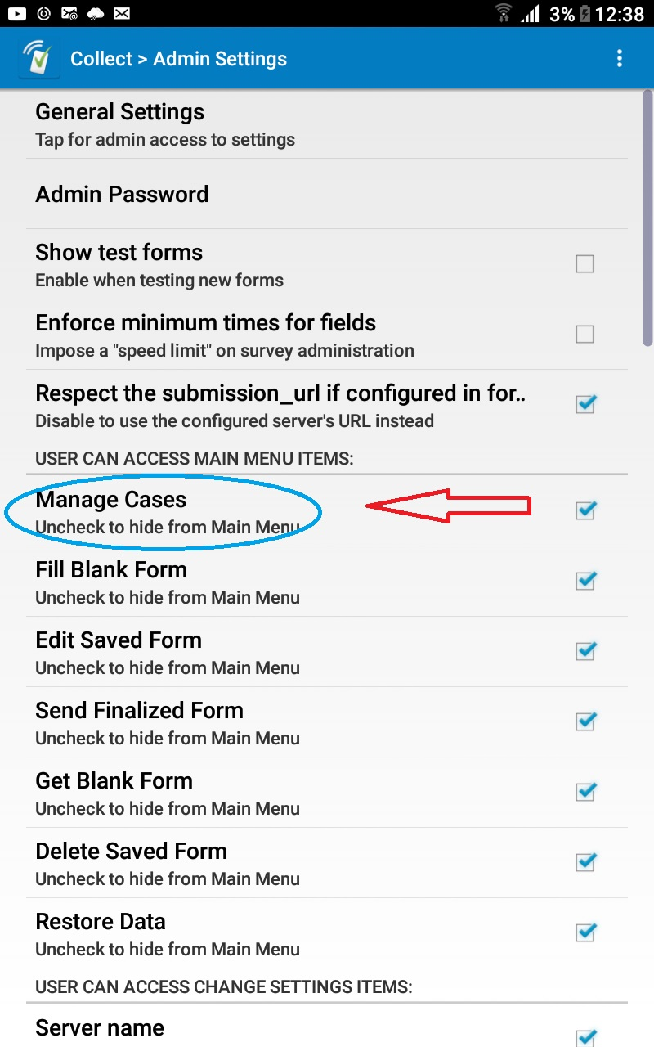
Case Management on SurveyCTO
New feature that facilitates phone surveys.
Enables generation and management of workplans through surveyCTO
To activate case management on your device, go to:
surveyCTO admin settings under user can access…select manage cases go back to main page
Go to “Get blank form” IRC-BILLY get a form called “IRC-BILLY COVID-19 Follow Up”

Slide 6
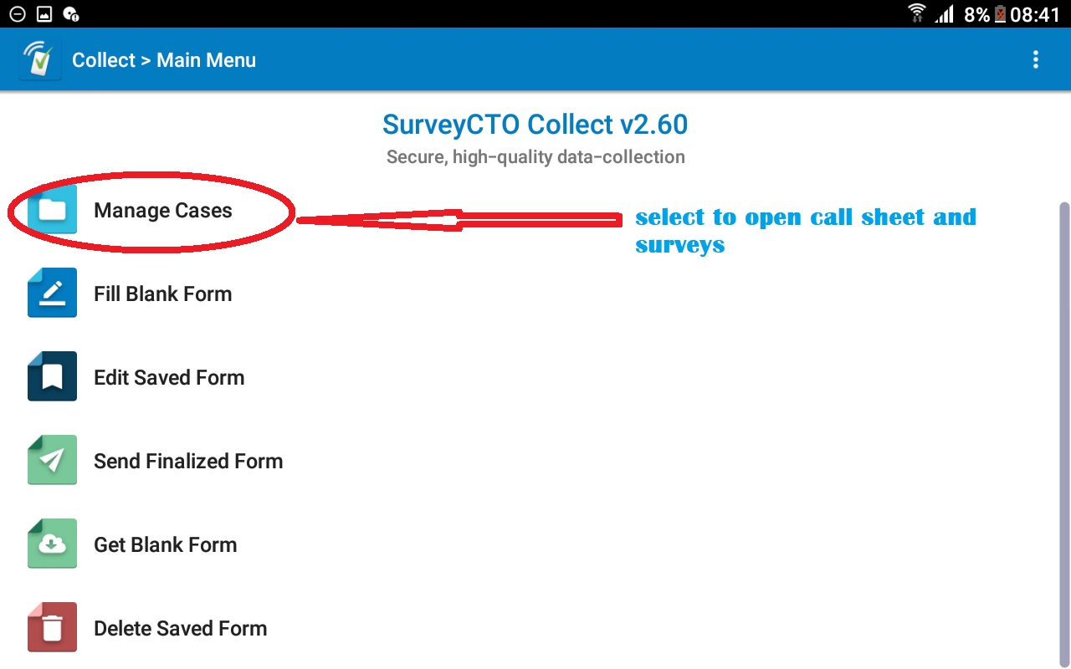
How to use Case Management
Step 1: Go to case management and open the call sheet

Slide 7
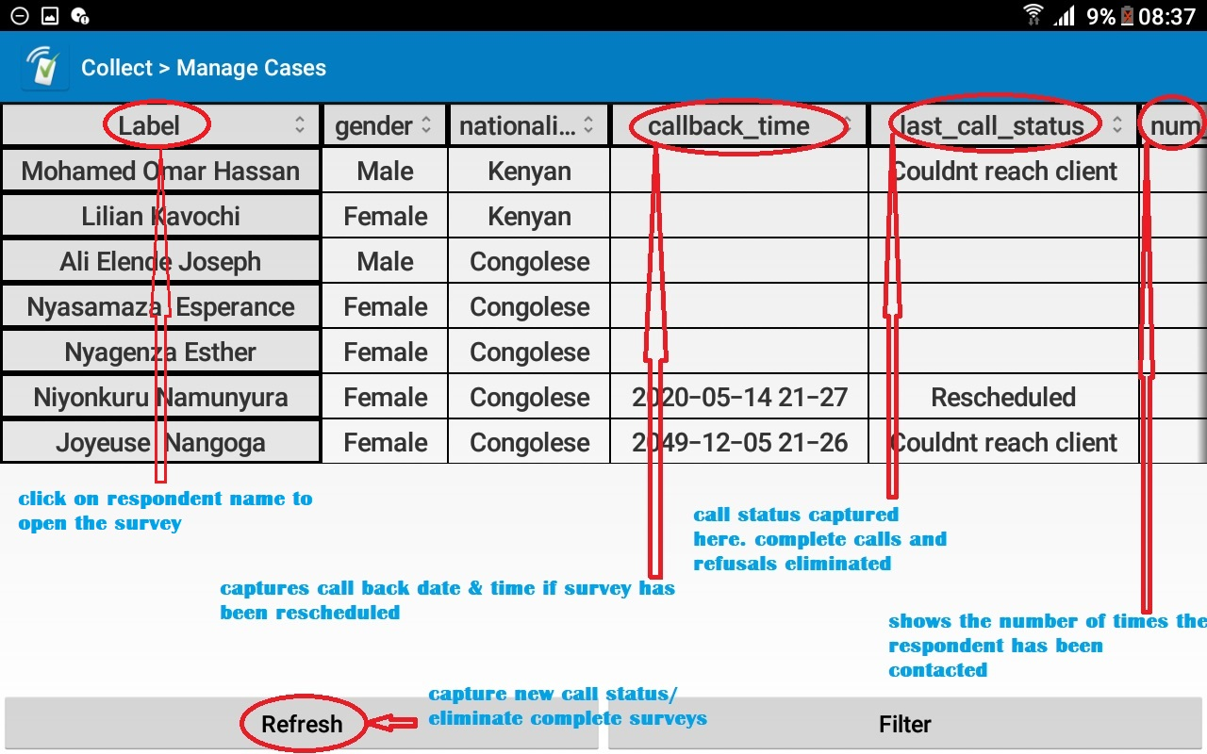
How to use Case Management
Step 2: Call sheet features

Slide 8
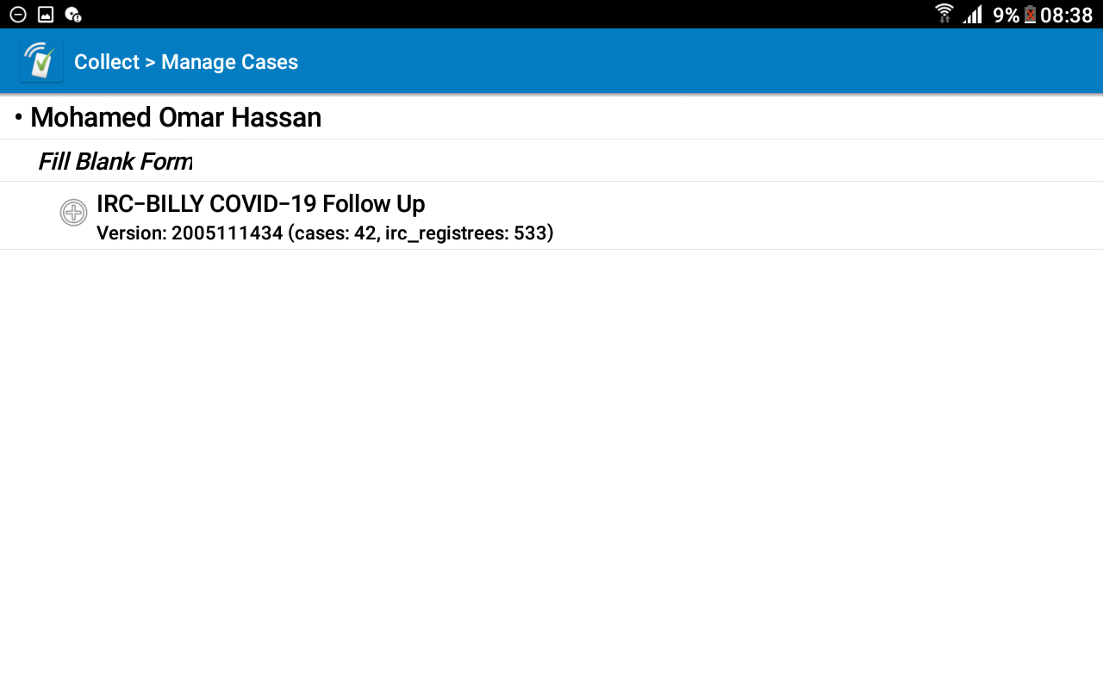
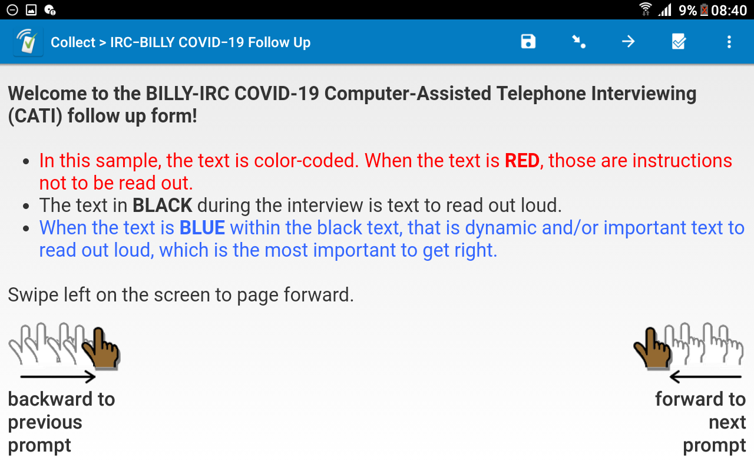
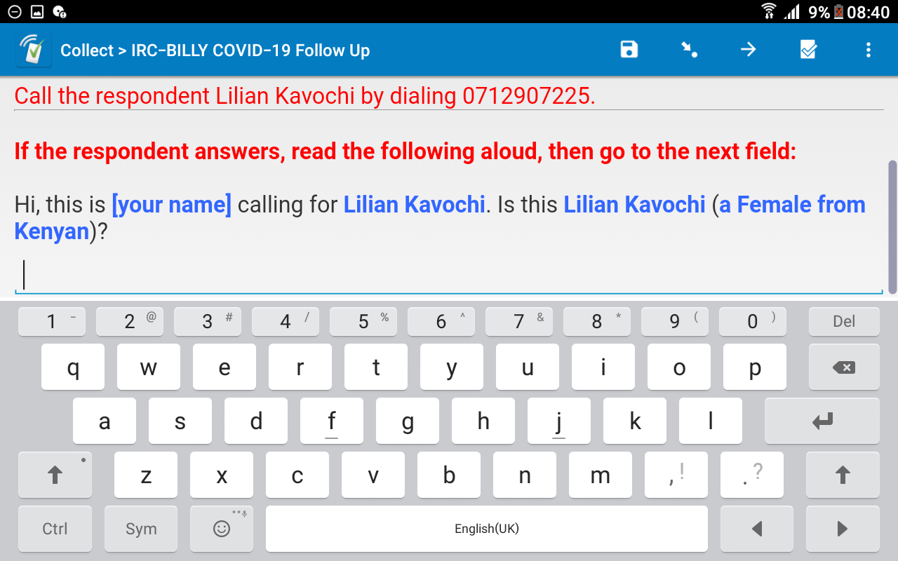
How to use Case Management
Step 3: Conducting the survey

Slide 9
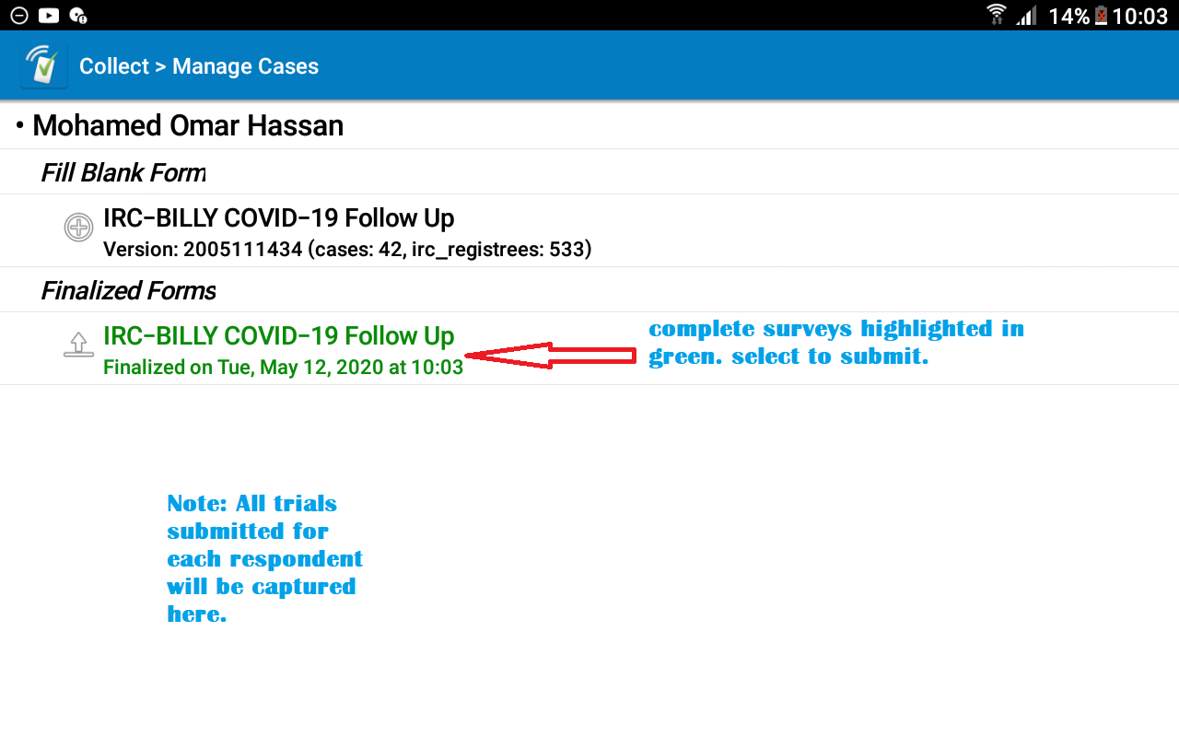
How to use Case Management
Step 4: survey submission
Survey saving process remains the same but to submit your survey, click on the saved finalized form and submit as shown on the diagram.

Slide 10
Practice Break & Lunch
Go through the survey on your own using the tablet. Note down any issues with questions or skip patterns. (Be very specific on the question)
Call a colleague or interview any adult member available in your household.
Try not to break in between and make it as real as possible and submit the survey after completion. We are trying to establish the average survey time among other issues.
We reconvene at 3pm for the remainder of the training.

Slide 11
Phone Survey Protocol
Before you start your day, make sure that:
You are in a quiet environment
Your tablet has the correct date and time
All your devices are fully charged (tablet, office & personal phone)
Have the right survey version
You have data on your table and airtime on your work phone
Clockify attendance
Attended daily debrief zoom call

Slide 12
Phone Survey Protocol - Consent
Before you conduct a survey, make sure that:
Introduce yourself, your organization & project.
Confirm that you speaking to the right client.
Client is aware of the purpose of your call, is in a quiet environment and knows the duration of survey.
Client is aware of his rights as a research participant.

Slide 13
Phone Survey Protocol – Call attempts
Every call MUST be attempted atleast 9 times
Make 3 attempts at 2-3 hour intervals in the course of the day and submit the survey status to update the call sheet.
If still not reachable at the end of day, follow the same protocol for the next 2 days.
Call back immediately if you receive notification of the line being back online
Send client a text informing them who you are.
Read through your protocol for additional info. And always refer to it when trouble-shooting.

Slide 14
Quality and Resource Control
Quality Checks
Backchecks – Everyday, 10% of your clients will be randomly called back for data verification.
High Frequency Checks – We’ll look through all surveys on a daily basis and flag off any issues we find.
Resource Control
Will require you to update us your airtime balance at the end of each day
Safaricom will share reports on data and airtime usage on the sim cards provided.
Any usage on activity not related to work will result to disciplinary action and the amount deducted from your wages.
We shall monitor your daily time use through clockify and CTO.

Slide 15
Targets & Timelines
We expect a minimum of 10 complete surveys every day
The exercise should last between 7-10 days and payment shall be for the days worked.
*************END*****************

